Slide 1
Module 4:
Manipulating Routing Updates
CCNP ROUTE: Implementing IP Routing
Notes:
Cisco Networking Academy Program
CCNP ROUTE: Implementing IP Routing
Chapter 4: Manipulating Routing Updates

Slide 2
Common Routing Performance Issues
Excessive routing updates
  CPU utilization can easily spike during this processing depending on:
    The size of the routing update
    The frequency of the updates
    The Layer 3 network design
The presence of any incorrectly configured route maps or filters
The number of routing protocols running in the same autonomous system
Notes:
Common network performance issues related to routing include the following:
Excessive routing updates—Excessive routing updates can decrease network performance, because if a Layer 3 switch or a router receives a large number of updates, it must process all of those updates. The size of the CPU utilization spike during this processing depends on the following factors:
The size of the routing update: This depends on the routing protocol used, the number of changes being reported, and the number of devices in the autonomous system (AS).
The frequency of the updates: This depends on the routing protocol used.
The design: The IP addressing plan and use of summarization can affect the number of routing updates sent.
The presence of any route maps or filters—Incorrectly configured route maps or filters can cause too much or the wrong data to be sent.
The number of routing protocols running in the same autonomous system—This affects the number of routing protocol processes receiving and processing the updates. Routes may also be redistributed between protocols, which can add to the number of updates that a specific protocol must process.

Slide 3
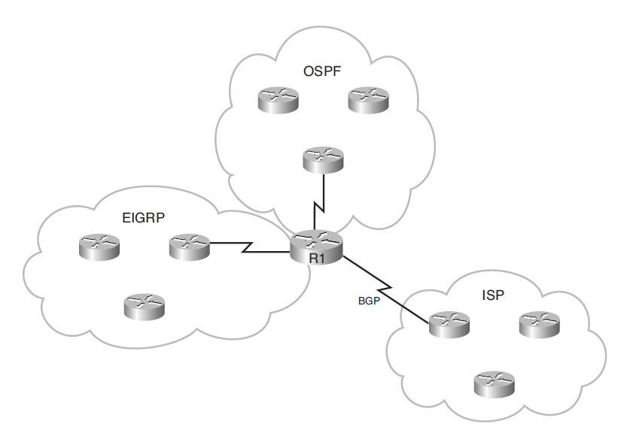
Running Multiple Protocols
Different routing protocols were not designed to interoperate with one another.
  Each protocol collects different types of information and reacts to topology changes in its own way.
Running muliple routing protocols increases CPU utilization and requires more memory resources to maintain all the topology, database and routing tables.
Notes:
Cisco routers allow internetworks using different routing protocols (referred to as routing domains or autonomous systems) to exchange routing information through a feature called route redistribution.
Route redistribution is the capability of boundary routers connecting different routing domains to exchange and advertise routing information between those routing domains.

Slide 4
Routing Protocol Performance Solutions
Design changes, such as limiting the number of routing protocols used.
Using passive interfaces to prevent routing protocol updates from being advertised out an interface.
Route filtering techniques to block specific routes from being advertised:
  Access control lists (ACLs)
  Route maps
Notes:
ACLs are usually associated with interfaces and are usually used to control user traffic (data plane traffic) rather than routing protocol traffic (or other control plane traffic).
Using route maps, distribute lists, or prefix lists instead of access lists for route filtering gives the administrator greater flexibility in determining just which routes will be permitted and which will be denied.

Slide 5
Route Filtering
Using route maps instead of access lists provides greater route filtering flexibility.
Filters can be configured to:
  Prevent updates through router interfaces.
  Control the advertising of routes in routing updates.
  Control the processing of routing updates.
If filters are not configured correctly or if filters are applied to wrong interfaces, network performance issues may occur.

Slide 6
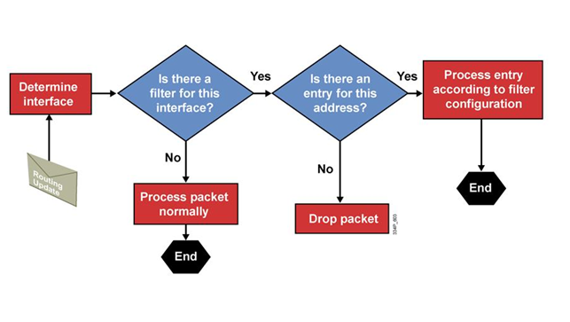
Route Filtering Process
A router stores the incoming routing update in the buffer and triggers a decision.
Is there an incoming filter applied to this interface?
  If no, then the routing update packet is processed normally.
Otherwise, is there an entry in the filter matching the routing update packet?
  If no, then the routing update packet is dropped.
Otherwise, the router processes the routing update according to the filter.

Slide 7
Simple to Complex Networks
Simple routing protocols work well for simple networks.
  Typically only require one routing protocol.
Running a single routing protocol throughout your entire IP internetwork is desirable.
However, as networks grow they become more complex and large internetworks may have to support several routing protocols.
  Proper inter-routing protocol exchange is vital.

Slide 8
Why have multiple routing protocols?
Interim during conversion
  Migrating from an older IGP to a new IGP.
Application-specific protocols
  One size does not always fit all.
Political boundaries
  Multiple departments managed by different network administrators
  Groups that do not work well with others
Mismatch between devices
  Multivendor interoperability
  Host-based routers
Company mergers
Notes:
The many reasons why a change in routing protocols or running multiple protocols might be required, resulting in a more complex routing environment, include the following:
You are migrating from an older IGP to a new IGP. Multiple redistribution boundaries may exist until the new protocol has displaced the old protocol completely. Running multiple routing protocols during a migration is effectively the same as a network that has multiple routing protocols running as part of its design.
You want to use another protocol but need to keep the old routing protocol because of the host system’s needs. For example, UNIX host-based routers might run only RIP.
Different departments might not want to upgrade their routers to support a new routing protocol.
If you have a mixed-router vendor environment, you can use a Cisco-specific routing protocol, such as EIGRP, in the Cisco portion of the network and then use a common standards-based routing protocol, such as OSPF, to communicate with non-Cisco devices.
Your network may become larger and more complex because of political and geographic border issues, and as you merge with or are acquired by other organizations.
Your organization uses a Layer 3 Multiprotocol Label Switching (MPLS) virtual private network (VPN) service from a service provider that does not use the same IGP as the rest of your network.

Slide 9
Complex Networks
Complex networks require careful routing protocol design and traffic optimization solutions, including the following:
  Redistribution between routing protocols
  Route filtering
  Summarization (covered in OSPF)

Slide 10
Redistribution
Cisco routers allow different routing protocols to exchange routing information through a feature called route redistribution.
  Route redistribution is defined as the capability of boundary routers connecting different routing domains to exchange and advertise routing information between those routing domains (autonomous systems).

Slide 11
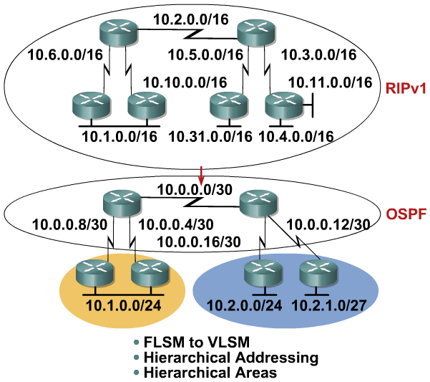
Route Redistribution Example
Notes:
This network initially used RIP Version 1 (RIPv1) and is migrating to OSPF, necessitating the following changes:
Conversion of the old fixed-length subnet mask (FLSM) addressing scheme to a variable-length subnet mask (VLSM) configuration
Use of a hierarchical addressing scheme to facilitate route summarization and make the network more scalable
Division of the network from one large area into a transit backbone area and two other areas

Slide 12
Redistributed Routes
Redistribution is always performed outbound; the router doing redistribution does not change its routing table.
The boundary router’s neighbors see the redistributed routes as external routes.
Routes must be in the routing table for them to be redistributed.
Notes:
As a review, remember there may be many reasons why an enterprise uses two or more interior gateway routing protocols. Whatever the reason for the change, network administrators must conduct migration from one routing protocol to another carefully and thoughtfully. The new routing protocol will most likely have different requirements and capabilities from the old one.
It is important for network administrators to understand what must be changed and to create a detailed plan before making any changes. An accurate topology map of the network and an inventory of all network devices are also critical for success.

Slide 13
Redistribution Considerations
The key issues that arise when using redistribution:
  Routing feedback (loops)
    If more than one boundary router is performing route redistribution, then the routers might send routing information received from one autonomous system back into that same autonomous system.
  Incompatible routing information
    Each routing protocol uses different metrics to determine the best path therefore path selection using the redistributed route information might not be optimal.
  Inconsistent convergence times
    Different routing protocols converge at different rates.
Good planning should solve the majority of issues but additional configuration might be required.
  Some issues might be solved by changing the administrative distance, manipulating the metrics, and filtering using route maps.

Slide 14
Selecting the Best Route
Routers use the following two parameters to select the best path:
Administrative distance:
  Used to rate a routing protocol’s believability (also called its trustworthiness).
  This criterion is the first thing a router uses to determine which routing protocol to believe if more than one protocol provides route information for the same destination.
Routing metric:
  The routing metric is a value representing the path between the local router and the destination network, according to the routing protocol being used.
  The metric is used to determine the routing protocol’s “best” path to the destination.

Slide 15

Cisco IOS Administrative Distance
Routing Protocol | Default Administrative Distance Value
Connected interface | 0
Static route out an interface | 1
Static route to a next-hop address | 1
EIGRP summary route | 5
External BGP | 20
Internal EIGRP | 90
IGRP | 100
OSPF | 110
IS-IS | 115
RIPv1 and RIP v2 | 120
Exterior Gateway Protocol (EGP) | 140
On-Demand Routing (ODR) | 160
External EIGRP | 170
Internal BGP | 200
Unknown | 255
More
Less
Notes:
Administrative Distance
Lower administrative distances are considered more believable (better).
Static routes are configured with the ip route prefix mask {address | interface-type interface-number [ip-address]} [dhcp] [distance] [name next-hop-name] [permanent | track number] [tag tag] global configuration command. If the address parameter is used in this command, specifying the address of the next-hop router to use to reach the destination network, the default administrative distance is 1. If the interface parameter is used instead, specifying the local router outbound interface to use to reach the destination network, the router considers this a directly connected route; however, the default administrative distance in this case appears to be somewhere between 0 and 1.

Slide 16
Routing Metric
A boundary router must be capable of translating the metric of the received route into the receiving routing protocol.
  Redistributed route must have a metric appropriate for the receiving protocol.
The Cisco IOS assigns the following default metrics when a protocol is redistributed into the specified routing protocol:
Protocol That Route Is Redistributed Into … | Default Seed Metric
RIP | 0 (interpreted as infinity)
IGRP / EIGRP | 0 (interpreted as infinity)
OSPF | 20 for all except BGP routes (BGP routes have a default seed metric of 1)
IS-IS | 0
BGP | BGP metric is set to IGP metric value
Notes:
A metric of infinity tells the router that the route is unreachable, and therefore, it should not be advertised. When redistributing routes into RIP, IGRP, and EIGRP, you must specify a default metric. If you do not configure a default metric, the default will be infinity which means that all routes redistributed from these three protocols will be unreachable.
For OSPF, the redistributed routes have a default type 2 metric of 20, except for redistributed BGP routes, which have a default type 2 metric of 1. For IS-IS, the redistributed routes have a default metric of 0. But unlike RIP, IGRP, or EIGRP, a seed metric of 0 will not be treated as unreachable by IS-IS. Configuring a seed metric for redistribution into IS-IS is recommended.
For BGP, the redistributed routes maintain the IGP routing metrics.

Slide 17
Defining a Seed Metric
A seed metric, different than the default metric, can be defined during the redistribution configuration.
  After the seed metric for a redistributed route is established, the metric increments normally within the autonomous system.
    The exception to this rule is OSPF E2 routes.
Seed metrics can be defined in two ways:
  The default-metric router configuration command establishes the seed metric for all redistributed routes.
  The redistribute can also be used to define the seed metric for a specific protocol.

Slide 18

OSPF Seed Metric Example #1
R3(config)# router rip
R3(config-router)# network 172.18.0.0
R3(config-router)# network 172.19.0.0
R3(config-router)# router ospf 1
R3(config-router)# network 192.168.2.0 0.0.0.255 area 0
R3(config-router)# redistribute rip subnets metric 30
R3(config-router)#
RIP AS
OSPF
Cost = 100
R1
R2
R3
R4
172.20.0.0
172.19.0.0
192.168.2.0
Cost = 10
172.16.0.0
172.17.0.0
172.18.0.0
192.168.4.0
Table R1
Table R2
Table R3
Table R4
C 172.16.0.0
C 172.20.0.0
R [120/1] 172.17.0.0
R [120/1] 172.19.0.0
R [120/2] 172.18.0.0
C 172.17.0.0
C 172.19.0.0
C 172.20.0.0
R [120/1] 172.16.0.0
R [120/1] 172.18.0.0
C 172.18.0.0
C 172.19.0.0
R [120/1] 172.17.0.0
R [120/1] 172.20.0.0
R [120/2] 172.16.0.0
C 192.168.2.0
O [110/110] 192.168.1.0
C 192.168.1.0
C 192.168.2.0
O E2 [110/30] 172.16.0.0
O E2 [110/30] 172.17.0.0
O E2 [110/30] 172.18.0.0
O E2 [110/30] 172.19.0.0
O E2 [110/30] 172.20.0.0
Notes:
As we know, each routing protocol defines a metric for each route. When a router redistributes routes from one routing domain to another this information cannot be translated from one routing protocol to another. A RIP hop cannot be dynamically recalculated to an OSPF cost by the router doing redistribution.
Therefore, a seed metric is used to artificially set the distance, cost, etc., to each external (redistributed) network from the redistribution point.
For example, OSPF has been defined to make the seed metric for redistributed RIP routes to be 30.
If the link cost of the Serial link to R4 is 100. The routes are redistributed as E2 routes, so the cost for networks 172.16.0.0, 172.17.0.0, and 172.18.0.0 in R4 is only the seed metric (30).
Notice that the metrics of the three networks in the RIP cloud are irrelevant in the OSPF cloud because the router in the OSPF network (R4) forwards any traffic for these three networks to the border (redistributing) router, R3. R3 then forwards the traffic within the RIP network appropriately.

Slide 19
OSPF Seed Metric Example #2
R3(config)# router rip
R3(config-router)# network 172.18.0.0
R3(config-router)# network 172.19.0.0
R3(config-router)# router ospf 1
R3(config-router)# network 192.168.2.0 0.0.0.255 area 0
R3(config-router)# redistribute rip subnets
R3(config-router)# default-metric 30
RIP AS
OSPF
Cost = 100
R1
R2
R3
R4
172.20.0.0
172.19.0.0
192.168.2.0
Cost = 10
172.16.0.0
172.17.0.0
172.18.0.0
192.168.4.0
Table R1
Table R2
Table R3
Table R4
C 172.16.0.0
C 172.20.0.0
R [120/1] 172.17.0.0
R [120/1] 172.19.0.0
R [120/2] 172.18.0.0
C 172.17.0.0
C 172.19.0.0
C 172.20.0.0
R [120/1] 172.16.0.0
R [120/1] 172.18.0.0
C 172.18.0.0
C 172.19.0.0
R [120/1] 172.17.0.0
R [120/1] 172.20.0.0
R [120/2] 172.16.0.0
C 192.168.2.0
O [110/110] 192.168.1.0
C 192.168.1.0
C 192.168.2.0
O E2 [110/30] 172.16.0.0
O E2 [110/30] 172.17.0.0
O E2 [110/30] 172.18.0.0
O E2 [110/30] 172.19.0.0
O E2 [110/30] 172.20.0.0

Slide 20
Redistribution Methods
Redistribution can be done through:
  One-point redistribution
    Only one router is redistributing one-way or two-way (both ways).
      There could still be other boundary routers but they are not configured to redistribute.
  Multipoint redistribution
    Multiple routers are used to redistribute either one-way or two-way (both ways).
    More prone to routing loop problems.
One-Point Redistribution
RIP
OSPF
Multipoint Redistribution
RIP
OSPF

Slide 21
One-Point Redistribution
One-point redistribution can be configured in either:
  One-point One-way
    Redistributes networks from one routing protocol into the other routing protocol.
    Typically uses a default or static route so that devices in that other part of the network can reach the first part of the network.
  One-point Two-way
    Redistributes routes between the two routing processes, in both directions.
One-Point One-Way Redistribution
RIP
OSPF
Redistributing from RIP to OSPF
Default route to the OSPF network
One-Point Two-Way Redistribution
RIP
OSPF
Redistributing from RIP to OSPF
and from OSPF to RIP
Notes:
In the one-point, one-way redistribution example, the OSPF domain would have knowledge of the RIP routes. However the RIP domain would require a static route to reach the OSPF domain.
In the one-point, two-way redistribution example, the RIP domain would know the OSPF networks, and the OSPF domain would know the RIP routes.

Slide 22
One-Point One-Way Redistribution Issue
Although one-point one-way or two-way redistribution is usually safe from routing loops, issues can still occur if multiple boundary routers exist and only one router is performing one-point one-way redistribution.
  In this example, R2 is redistributing an external EIGRP route into the OSPF domain.
Although R3 has a direct connection to R1, R3 will use the OSPF route via R2 to get to the 10.0.0.0 network due to the lower administrative distance of OSPF (110).
This creates a suboptimal routing issue.
Only R2 is configured to redistribute the EIGRP routes into the OSPF domain.
Therefore the external 10.0.0.0 network is redistributed into the OSPF domain with an administrative distance of 110.
3
2
OSPF
O E2 10.0.0.0/8 [110/20]
R2
R3
D EX 10.0.0.0/8 [170/41024000]
D EX 10.0.0.0/8 [170/41024000]
R1
EIGRP
R1 announces the external EIGRP route 10.0.0.0 with an administrative distance of 170 to both R2 and R3.
1
Notes:
The following example displays how one-point one-way redistribution can result in suboptimal routing .
Router R1 running EIGRP is announcing an external route to routers R2 and R3.
Both of these routers are running the two routing protocols OSPF and EIGRP, but the redistribution between EIGRP and OSPF only occurs on router R2.
Router R3 receives routing update information for the external route directly from router R1 via EIGRP, and via OSPF from router R2.
The administrative distance of OSPF (110) is lower than administrative distance of external EIGRP routes (170), so router R3 selects the OSPF route.
Instead of sending packets directly from router R3 to router R1, router R3 prefers the path via router R2, resulting in suboptimal routing.

Slide 23
Multipoint Redistribution
Multipoint redistribution has two (or more) separate routers running both routing protocols.
Redistribution can be configured as:
  Multipoint one-way redistribution
  Multipoint two-way redistribution
  Although multipoint two-way redistribution is especially problematic, either method is likely to introduce potential routing feedback loops.
Multipoint One-Way Redistribution
RIP
OSPF
Redistributing RIP into OSPF
Redistributing RIP into OSPF
Multipoint Two-Way Redistribution
RIP
OSPF
Redistributing RIP into OSPF and OSPF into RIP
Redistributing RIP into OSPF and OSPF into RIP

Slide 24
Multipoint Redistribution
Multipoint one-way redistribution only works well if:
  The receiving routing protocol is either EIGRP, BGP and OSPF because they support different administrative distances for internal and external routes.
  The administrative distance of protocol B’s external routes is higher than the administrative distance of protocol A’s routes, so that R2 and R3 will use the appropriate routes to destinations in the protocol A side of the network.
Routing Protocol A
Redistributed protocol B routes
2
R2 is configured to redistribute routing protocol B routes.
3
R3 is configured to redistribute routing protocol B routes.
R2
R3
Protocol B routes
Protocol B routes
R1
Routing Protocol B
R1 announces protocol B routes to both R2 and R3.
1

Slide 25
Preventing Routing Loops
The safest way to perform redistribution is to redistribute routes in only one direction, on only one boundary router within the network.
  However, that this results in a single point of failure in the network.
If redistribution must be done in both directions or on multiple boundary routers, the redistribution should be tuned to avoid problems such as suboptimal routing and routing loops.

Slide 26
Redistribution Guidelines
Do not overlap routing protocols.
  Do not run two different protocols in the same Internetwork.
  Instead, have distinct boundaries between networks that use different routing protocols.
Be familiar with your network.
  Knowing the network will result in the best decision being made.

Slide 27
Redistribution Supports All Protocols
R1(config)# router rip
R1(config-router)# redistribute ?
bgp Border Gateway Protocol (BGP)
connected Connected
eigrp Enhanced Interior Gateway Routing Protocol (EIGRP)
isis ISO IS-IS
iso-igrp IGRP for OSI networks
metric Metric for redistributed routes
mobile Mobile routes
odr On Demand stub Routes
ospf Open Shortest Path First (OSPF)
rip Routing Information Protocol (RIP)
route-map Route map reference
static Static routes
R1(config-router)# redistribute
Notes:
Redistribution supports all routing protocols. Additionally, static and connected routes can be redistributed to allow the routing protocol to advertise the routes without using a network statement for them.
Since routes are redistributed by the routing protocol, the redistribute command is given under the routing process that is to receive the routes.

Slide 28
Key Route Redistribution Points
Routes are redistributed into a routing protocol.
  Therefore, the redistribute command is configured under the routing process that is receiving the redistributed routes.
Routes can only be redistributed between routing protocols that support the same protocol stack.
  For example IPv4 to IPv4 and IPv6 to IPv6.
  However, IPv4 routes cannot be redistributed into IPv6.
The method used to configure redistribution varies among combinations of routing protocols.
  For example, some routing protocols require a metric to be configured during redistribution, but others do not.

Slide 29
Generic Redistribution Steps
Identify the boundary router(s) that will perform redistribution.
Determine which routing protocol is the core protocol.
Determine which routing protocol is the edge protocol.
  Determine whether all routes from the edge protocol need to be propagated into the core and consider methods that reduce the number of routes.
Select a method for injecting the required routes into the core.
  Summarized routes at network boundaries minimizes the number of new entries in the routing table of the core routers.
Consider how to inject the core routing information into the edge protocol.
Notes:
The following steps for configuring redistribution are generic enough to apply to all routing protocol combinations. However, the commands used to implement the steps vary, as identified in the following sections.
It is important that you review the Cisco IOS documentation for the configuration commands that apply to the specific routing protocols you want to redistribute.

Slide 30
Redistributing into RIP
Redistribute routes into RIP.
Router(config-router)#
redistribute protocol [process-id] [match route-type] [metric metric-value] [route-map map-tag]
Parameter | Description
protocol | The source protocol from which routes are redistributed.
process-id | For OSPF, this value is an OSPF process ID. For EIGRP or BGP, this value is an AS number. This parameter is not required for IS-IS.
route-type | (Optional) A parameter used when redistributing OSPF routes into another routing protocol.
metric-value | (Optional) A parameter used to specify the RIP hop count seed metric for the redistributed route. If this value is not specified and no value is specified using the default-metric router configuration command, then the default metric is 0 and interpreted as infinity which means that routes will not be redistributed.
map-tag | (Optional) Specifies the identifier of a configured route map to be interrogated to filter the importation of routes from the source routing protocol to the current RIP routing protocol.
Notes:
A metric-value must be specified or the default-metric command must be configured. A metric configured in a redistribute command overrides the value in the default-metric command for that one protocol.

Slide 31
Redistributing into RIP Example
R1(config)# router rip
R1(config-router)# redistribute ospf 1 metric 3
R1(config-router)#
OSPF
RIP
10.1.1.0 /24
192.168.1.0 /24
.1
.2
R1
Fa0/0
Fa0/0
R2
O 172.16.1.0/24 [110/50]
R 172.16.0.0 [120/3]
Table R1
Table R2
C 10.1.1.0
R 192.168.1.0 [120/1]
0 172.16.1.0 [110/50]
C 10.1.1.0
C 192.168.1.0
R 172.16.0.0 [120/3]
Notes:
On R1, routes from OSPF process 1 are redistributed into RIP and are given a seed metric of 3. Because no route type is specified, both internal and external OSPF routes are redistributed into RIP.
R2 learns about the 172.16.0.0 network from R1 via RIP; R2’s routing table has 172.16.0.0 installed as a RIP route. Notice that the route is automatically summarized by R1.

Slide 32
Redistributing into OSPF
Redistribute routes into OSPF.
Router(config-router)#
redistribute protocol [process-id] [metric metric-value] [metric-type type-value] [route-map map-tag] [subnets] [tag tag-value]
Parameter | Description
protocol | The source protocol from which routes are redistributed.
process-id | For EIGRP or BGP, this value is an AS number. This parameter is not required for RIP or IS-IS.
metric-value | (Optional) A parameter that specifies the OSPF seed metric used for the redistributed route. The default metric is a cost of 20 (except for BGP routes, which have a default metric of 1).
map-tag | (Optional) Specifies the identifier of a configured route map to be interrogated to filter the importation of routes from the source routing protocol to the current OSPF routing protocol.
subnets | (Optional) OSPF parameter that specifies that subnetted routes should be redistributed. Otherwise, only classful routes are redistributed.
tag-value | (Optional) A 32-bit decimal value attached to each external route to be used by ASBRs.
Notes:
A metric configured in a redistribute command overrides the value in the default-metric command for that one protocol.

Slide 33
Redistributing into OSPF Example
R1(config)# router ospf 1
R1(config-router)# redistribute eigrp 100 subnets metric-type 1
R1(config-router)#
EIGRP AS 100
OSPF
10.1.1.0 /24
192.168.1.0 /24
.1
.2
R1
Fa0/0
Fa0/0
R2
D 172.16.1.0/24 [90/409600]
O E1 172.16.1.0 [110/20]
Table R1
Table R2
C 10.1.1.0
0 192.168.1.0 [110/20]
D 172.16.1.0 [90/409600]
C 10.1.1.0
C 192.168.1.0
O E1 172.16.1.0 [110/20]
Notes:
Note that the subnets keyword is used so subnets are redistributed. If this keyword were omitted, no subnets would be redistributed into the OSPF domain (including the 172.16.1.0 subnet).
Omitting the subnets keyword is a common configuration error.
Also notice that a metric value is optional since OSPF will automatically assign a cost of 20 and identify the route as an E2 type route.

Slide 34
Default Metric for RIP, OSPF, BGP
Apply default metric values for RIP, OSPF, and BGP.
Router(config-router)#
default-metric number
The number parameter is the value of the metric.
  For RIP this is the number of hops.
  For OSPF this is the assigned cost.
Notes:
A metric configured in a redistribute command overrides the value in the default-metric command for that one protocol.

Slide 35
OSPF Default-Metric Example
R1(config)# router ospf 1
R1(config-router)# default-metric 30
R1(config-router)# redistribute eigrp 100 subnets metric-type 1
R1(config-router)#
EIGRP AS 100
OSPF
10.1.1.0 /24
192.168.1.0 /24
.1
.2
R1
Fa0/0
Fa0/0
R2
D 172.16.1.0/24 [90/409600]
O E1 172.16.1.0 [110/30]
Table R1
Table R2
C 10.1.1.0
0 192.168.1.0 [110/20]
D 172.16.1.0 [90/409600]
C 10.1.1.0
C 192.168.1.0
O E1 172.16.1.0 [110/30]

Slide 36
Redistributing into EIGRP
Redistribute routes into EIGRP.
Router(config-router)#
redistribute protocol [process-id] [match route-type] [metric metric-value] [route-map map-tag]
Parameter | Description
protocol | The source protocol from which routes are redistributed.
process-id | For OSPF, this value is an OSPF process ID. For BGP, this value is an AS number. This parameter is not required for RIP or IS-IS.
route-type | (Optional) A parameter used when redistributing OSPF routes into another routing protocol.
metric-value | Required if the default-metric command is not configured otherwise it is optional . A parameter that specifies the EIGRP seed metric, in the order of bandwidth, delay, reliability, load, and maximum transmission unit (MTU), for the redistributed route. If this value is not specified when redistributing from another protocol and no default metric has been configured, then no routes will not be redistributed.
map-tag | (Optional) Specifies the identifier of a configured route map to be interrogated to filter the importation of routes from the source routing protocol to the current EIGRP routing protocol.
Notes:
A metric-value must be specified or the default-metric command must be configured. A metric configured in a redistribute command overrides the value in the default-metric command for that one protocol.
Note: When redistributing a static or connected route into EIGRP, the default metric is equal to the metric of the associated static or connected interface, so the metric does not have to be specified.

Slide 37
Redistributing into EIGRP Example
R1(config)# router eigrp 100
R1(config-router)# redistribute ospf 1 metric 10000 100 255 1 1500
R1(config-router)#
OSPF
EIGRP AS 100
10.1.1.0 /24
192.168.1.0 /24
.1
.2
R1
Fa0/0
Fa0/0
R2
O 172.16.1.0/24 [110/50]
D EX 172.16.1.0/24 [170/281600]
Table R1
Table R2
C 10.1.1.0
0 192.168.1.0 [90/307200]
O 172.16.1.0 [110/50]
C 10.1.1.0
C 192.168.1.0
D EX 172.16.1.0 [170/307200]
Notes:
A metric is specified to ensure that routes are redistributed.
The metric configured in this example is interpreted as follows:
Bandwidth in kbps = 10,000
Delay in tens of microseconds = 100
Reliability = 255 (maximum)
Load = 1 (minimum)
MTU = 1500 bytes
The redistributed routes appear in Router B’s table as external EIGRP (D EX) routes with an administrative distance of 170 instead of the EIGRP default of 90. This makes internal EIGRP routes preferred over external EIGRP routes.

Slide 38
Default Metric for EIGRP
Apply metric values for EIGRP.
Router(config-router)#
default-metric bandwidth delay reliability loading mtu
Parameter | Description
bandwidth | The route’s minimum bandwidth in kilobits per second (kbps). It can be 0 or any positive integer.
delay | Route delay in tens of microseconds. It can be 0 or any positive integer that is a multiple of 39.1 nanoseconds.
reliability | The likelihood of successful packet transmission, expressed as a number from 0 to 255, where 255 means that the route is 100 percent reliable, and 0 means unreliable.
loading | The route’s effective loading, expressed as a number from 1 to 255, where 255 means that the route is 100 percent loaded.
mtu | Maximum transmission unit. The maximum packet size in bytes along the route; an integer greater than or equal to 1.
Notes:
A metric configured in a redistribute command overrides the value in the default-metric command for that one protocol.

Slide 39
EIGRP Default-Metric Example
R1(config)# router eigrp 100
R1(config-router)# default-metric 10000 100 255 1 1500
R1(config-router)# redistribute ospf 1
R1(config-router)#
OSPF
EIGRP AS 100
10.1.1.0 /24
192.168.1.0 /24
.1
.2
O 172.16.1.0/24 [110/50]
R1
Fa0/0
Fa0/0
R2
D EX 172.16.1.0/24 [170/281600]
Table R1
Table R2
C 10.1.1.0
0 192.168.1.0 [90/307200]
O 172.16.1.0 [110/50]
C 10.1.1.0
C 192.168.1.0
D EX 172.16.1.0 [170/307200]

